Slide 1
Renewable Energy Market Trend Analysis
Three Key Markets : Solar, Hydrogen, Wind
Team 10 Members:
Austin Hwang, Olga Petrova, Philip Peters, Shalini Pampati, Yannis Papadopoulos, Dahlia Segarra

Slide 2
Overview
Objective
Compare 10-year stock price trends in Solar, Hydrogen, and Wind sectors
Key Findings
Growth and Decline patterns identified in each sector
Market shifts driven by external factors
Outcome
Insights into sector performance
Evolution in the renewable energy market

Slide 3


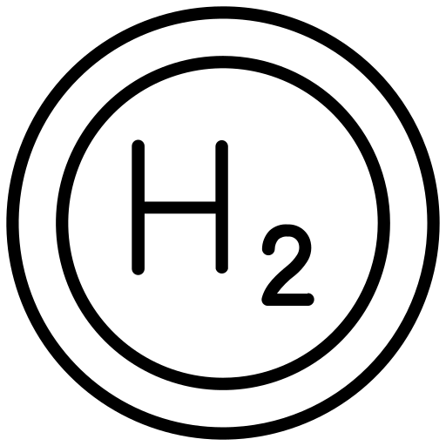

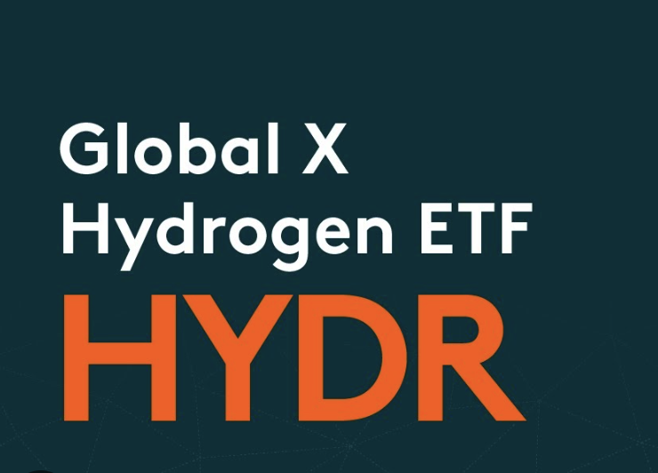










Renewable Energy Sector Details
Solar
Hydrogen
Wind
ETF
Stock
ETF
Stock
ETF
Stock

Slide 4
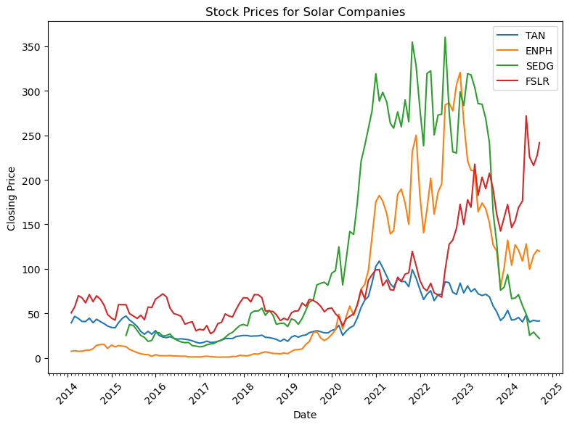
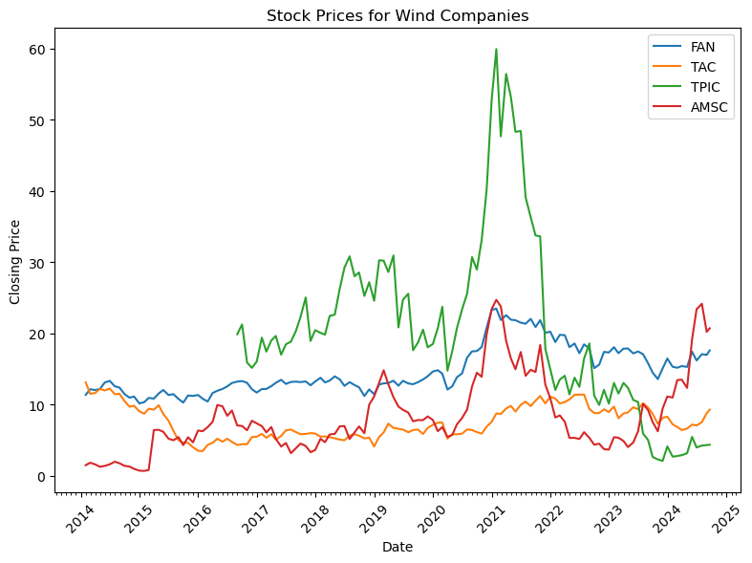
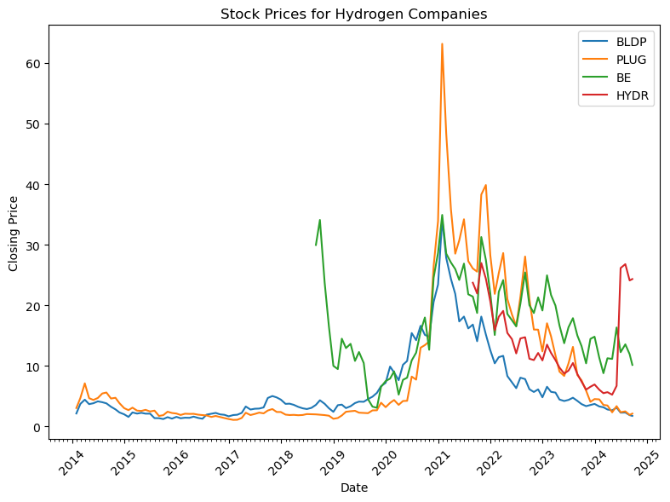
Which sector (Solar, Wind, or Hydrogen) has shown the highest average stock price growth over the past 10 years?
Discussion Point # 1 (Yannis)
How have the stocks done over the last 10 years?
1 out of 4 companies looked at in each sector have improved.
Spikes: 2020 to 2022
Dip: 2022 to Date.
How has their Average Price per Year changed?
Hydrogen has low performance the last few years.
FSLR, HYDR, and AMSC have seen recent Growth.
How has their Peak Performance per Year changed?
Solar has Highest peak and prices
Peak Performance decrease since 2022
FSLR, HYDR, and AMSC have made a come back.

Slide 5
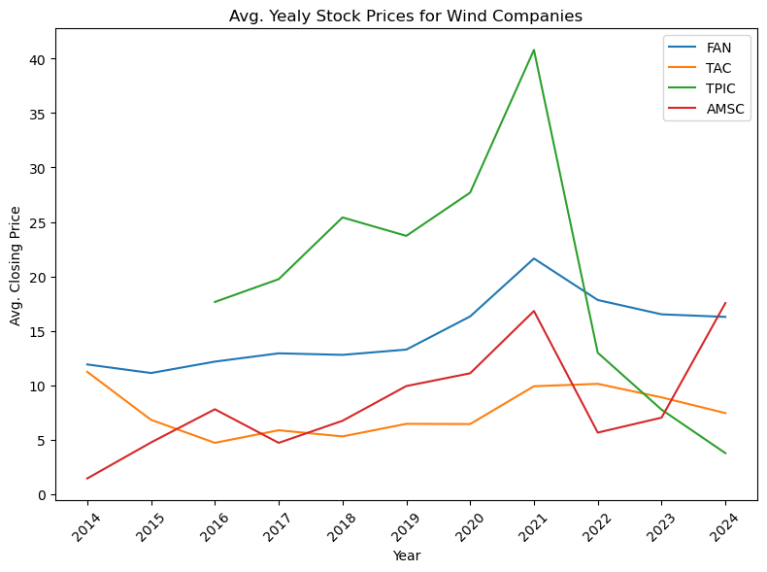
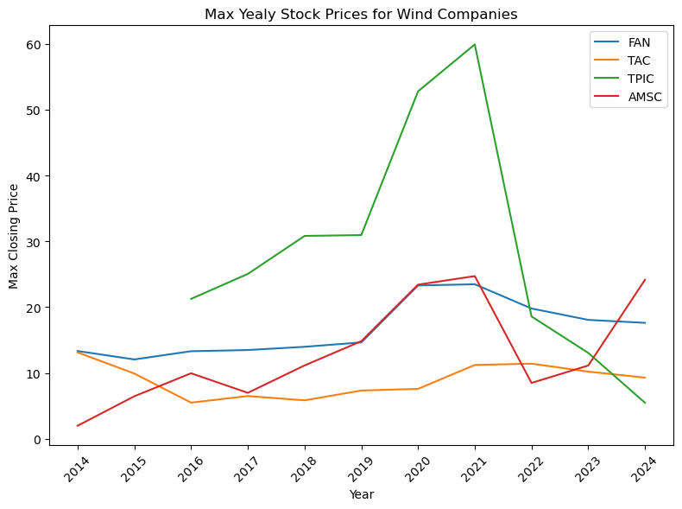
Discussion Point # 1 (Yannis)
Volatility Comparison: Wind sector most stable
Investment Insights: Stability trends for informed decisions
Top Stocks: FAN (First Trust Global Wind Energy ETF), AMSC (American Superconductor)

Slide 6
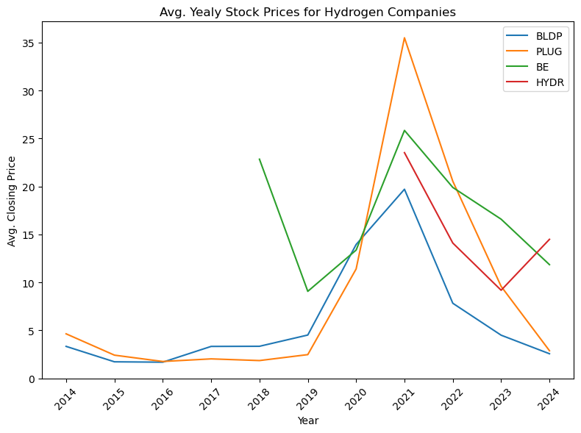
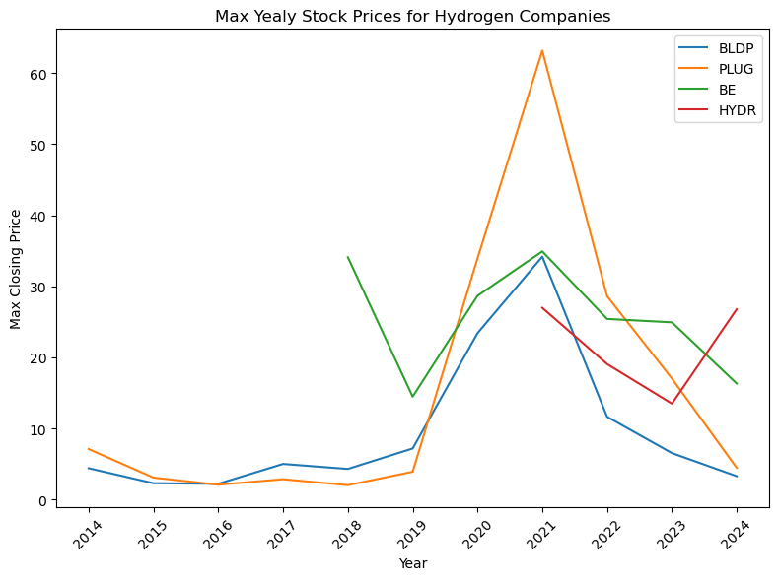
Discussion Point # 1 (Yannis)
Volatility Analysis: Hydrogen sector is the most unstable
Top Stocks: HYDR (Global X Hydrogen ETF), BE (Bloom Energy)

Slide 7
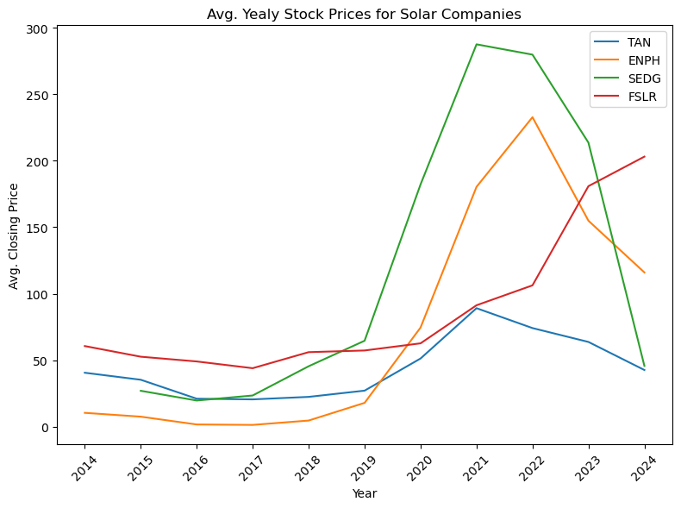
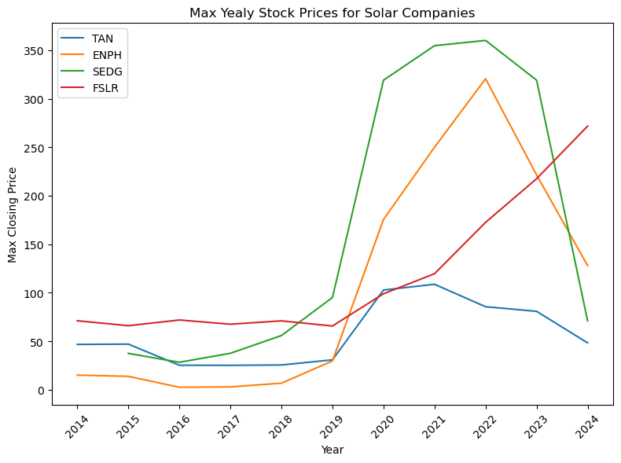
Discussion Point # 1 (Yannis)
Growth Comparison: Solar sector leads in growth
Top Stocks: Enphase Energy (ENPH), First Solar (FSLR)

Slide 8
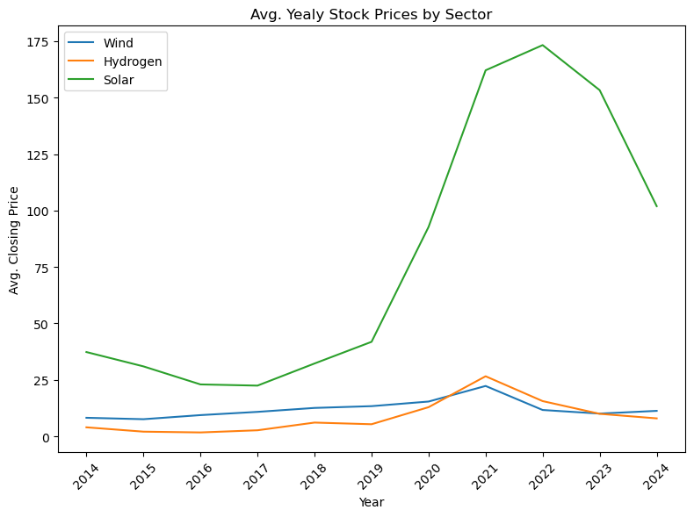
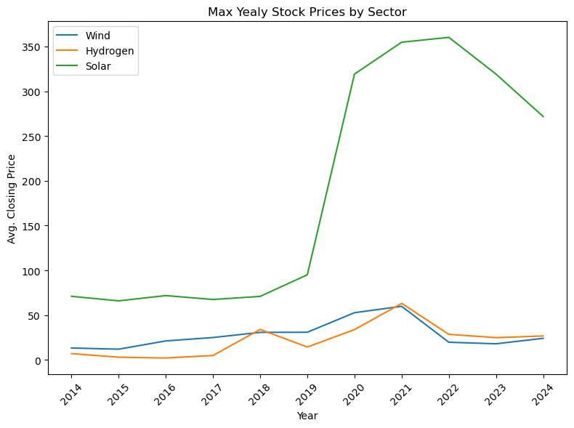
Discussion Point # 1 (Yannis)
Growth Comparison: Solar has had a larger drop off but still maintains higher stock prices.

Slide 9
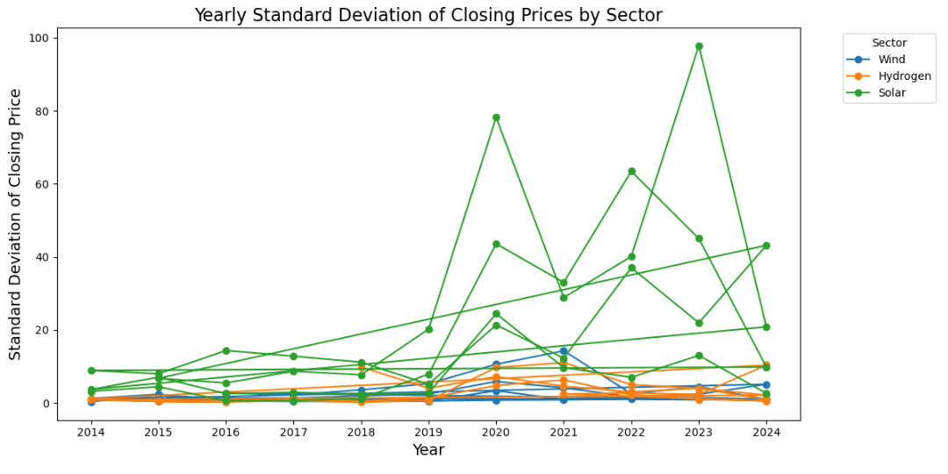
How does the volatility of stock prices in each sector compare, and which sector has shown more stability over the past 10 years?
Discussion Point # 2 (Shalini)

Slide 10
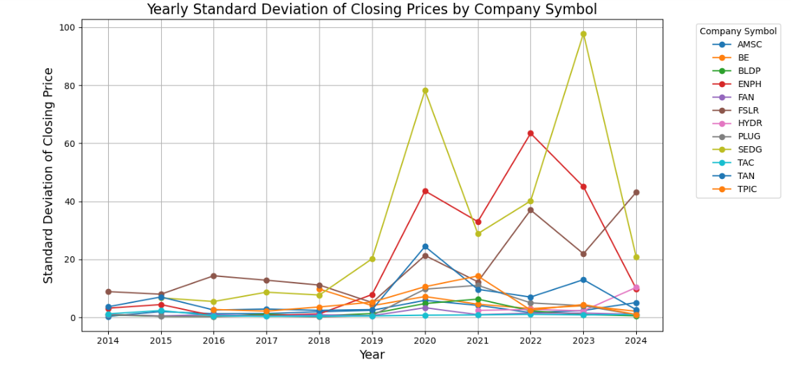
Volatility of stock prices by company symbol
Discussion Point # 2 (Shalini)

Slide 11
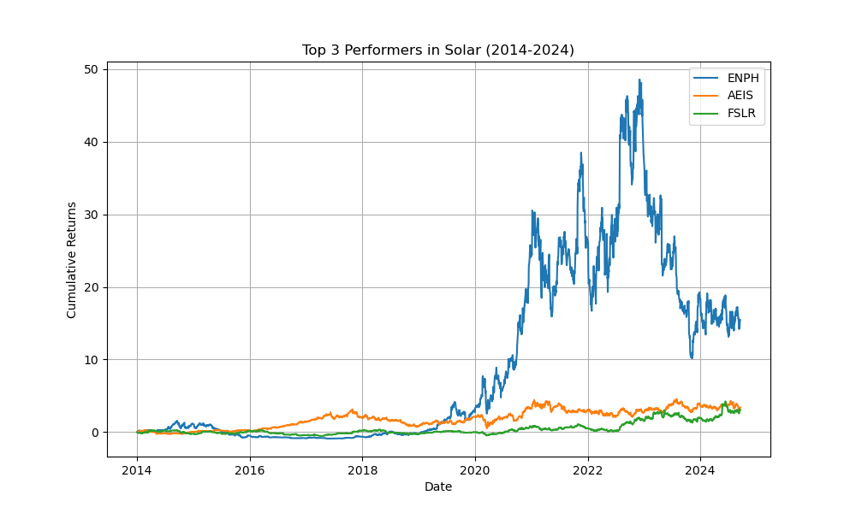
Which individual stocks within each sector have outperformed their peers and what might be contributing to their success?
Discussion Point # 3 (Olga)
Top Performer - Solar:
Enphase Energy (ENPH ). Enphase energy is an inventor of micro inverter technology that is used in most solar batteries today.
First Solar (FSLR) is one of the leaders in solar panel business.
Advanced Energy Industry (AEIS). Their products include thin-film power-conversion systems and power control modules.
:

Slide 12
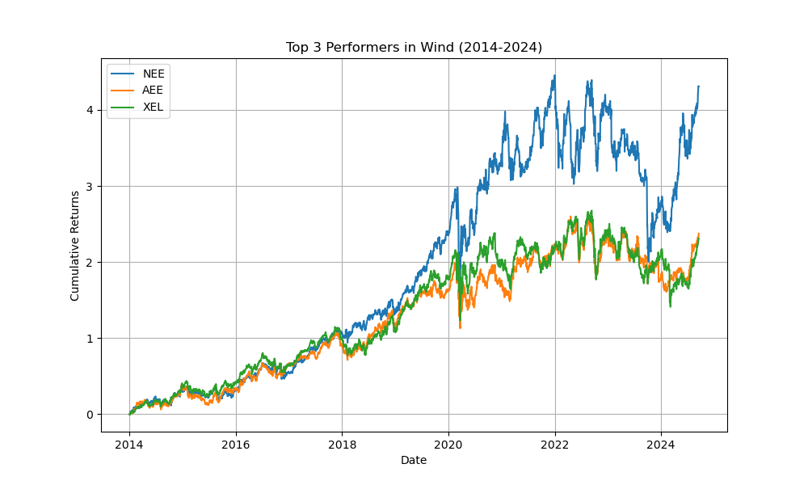
Discussion Point # 3 (Olga)
Wind: Top performer of the wind sector was
NextEra Energy Company (NEE).
Ameren Corporation(AEE)
Xcel Energy (XEL) also performed very well, especially during the last year. We have to keep in mind that most Wind energy companies are energy companies, that sell gas and oil, and overall are utilities companies.

Slide 13
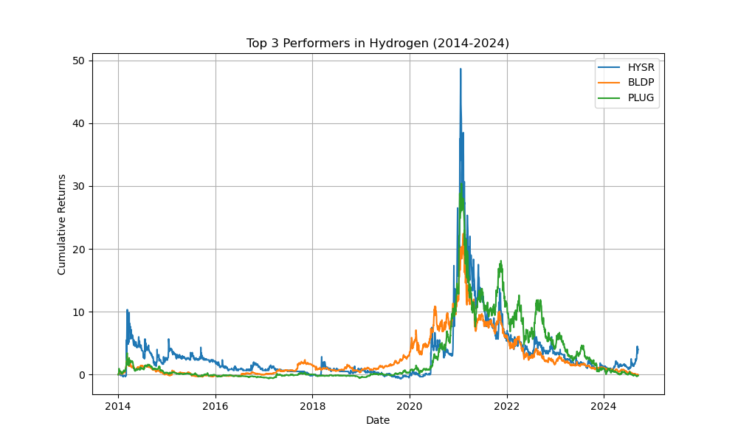
Hydrogen: Top Performers Sunhydrogen (HYSR)
Discussion Point # 3 (Olga)
Hydrogen: Hydrogen companies performance was very rocky over the past 10 years.
Sunhydrogen (HYSR) stock spike in 2021, pushed by a sudden international interest in investing in hydrogen technology.
Ballard Power Systems (BLDP)
Plug Power (PLUG) were better performing stocks. But with uncertain government policies toward hydrogen power, cost of transportation, and increased interest in solar energy, hydrogen technology stocks are lagging behind and losing investors interest.

Slide 14
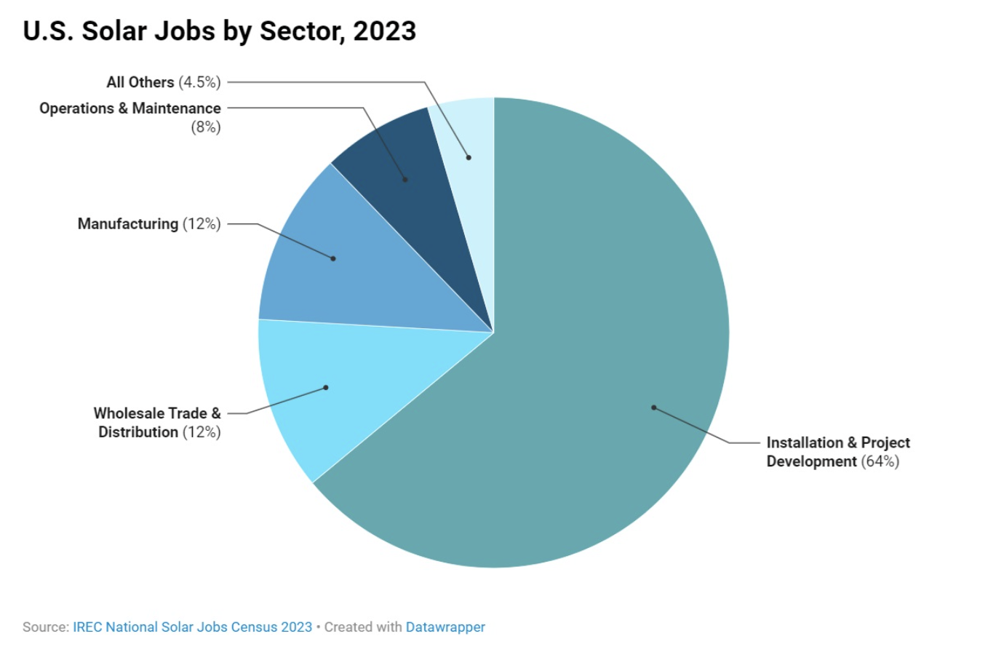
Are there any significant events that have could have impacted stock price trends in these sectors, and how did each sector respond?
Discussion Point # 4 (Dahlia)
SRM Advances in Hydrogen technology
SRM “Steam Methane Reforming”: Efficient process for hydrogen production
reduce the energy input or achieve better product separation
sorption-enhanced-steam-reforming (SESR) - produces high-purity hydrogen
Northern China’s Demand Increase for Wind
Global orders increased 23% in 2024
Sudden increase almost exclusively due to demand increase in Northern China
Western manufacturers contributed only 13%
Covid 19 and the Solar Industry
Difficult start with initial halt to most residential and commercial installations
Record breaking installations due to productivity improvements
Work-from-home jobs led to increase in solar installations in the home
Slowly began reaching reaching pre-Covid employment levels

Slide 15
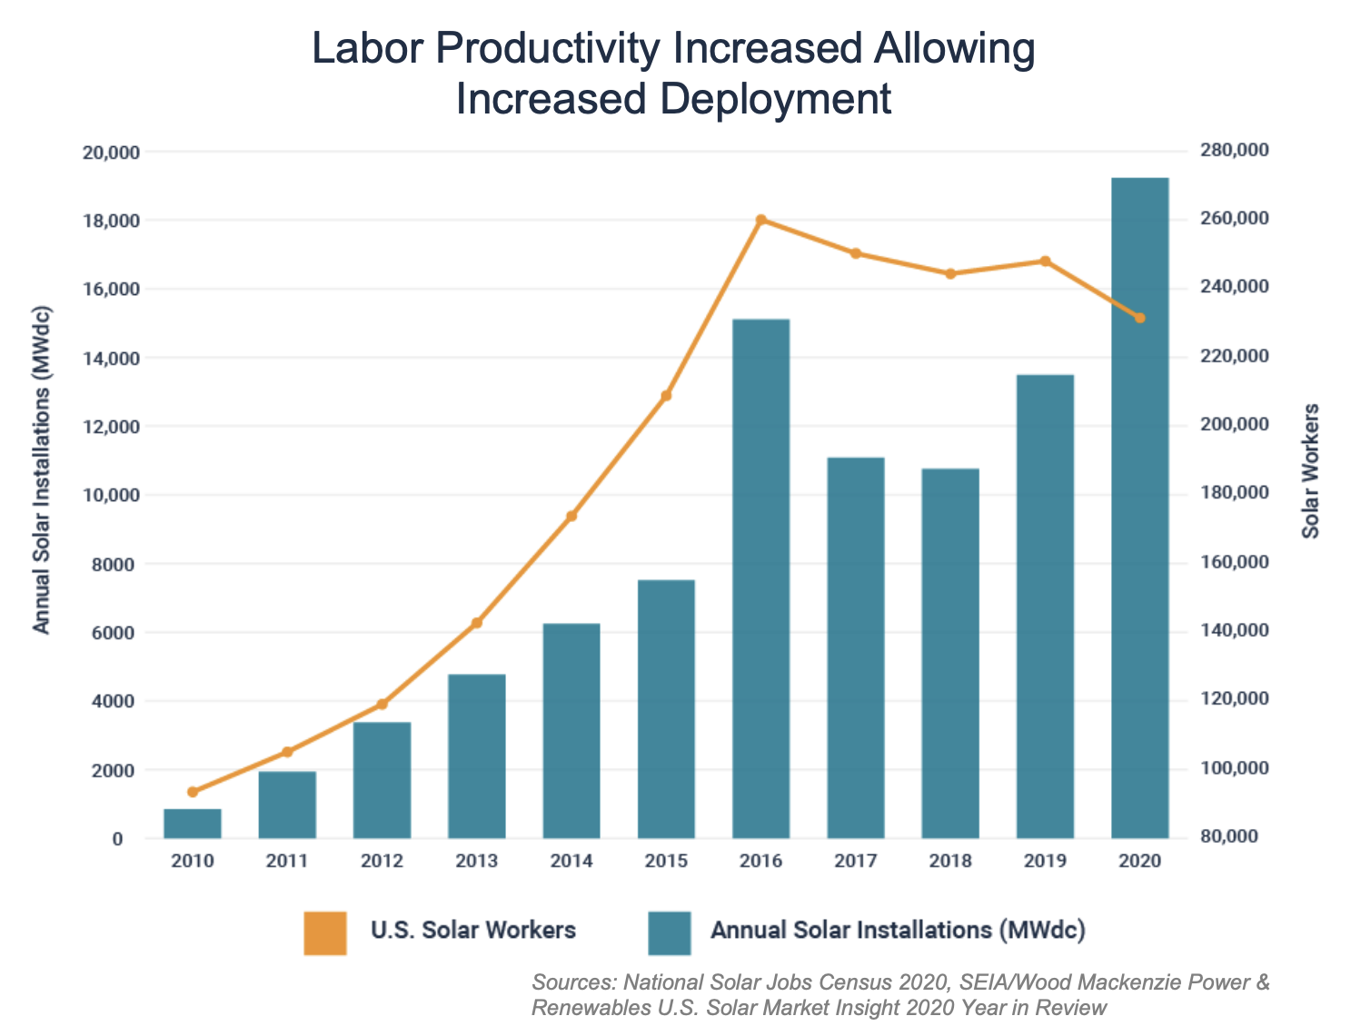
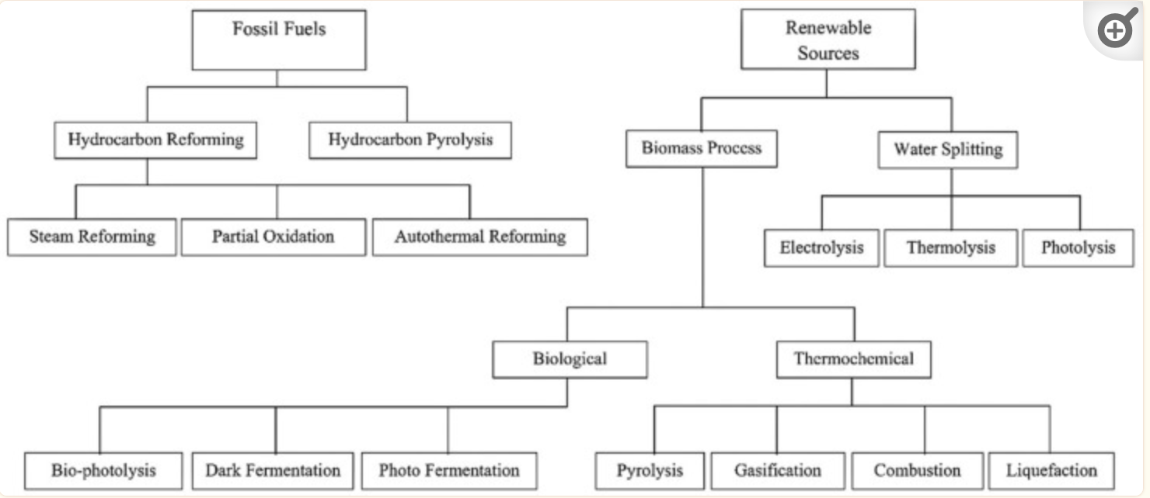

Slide 16
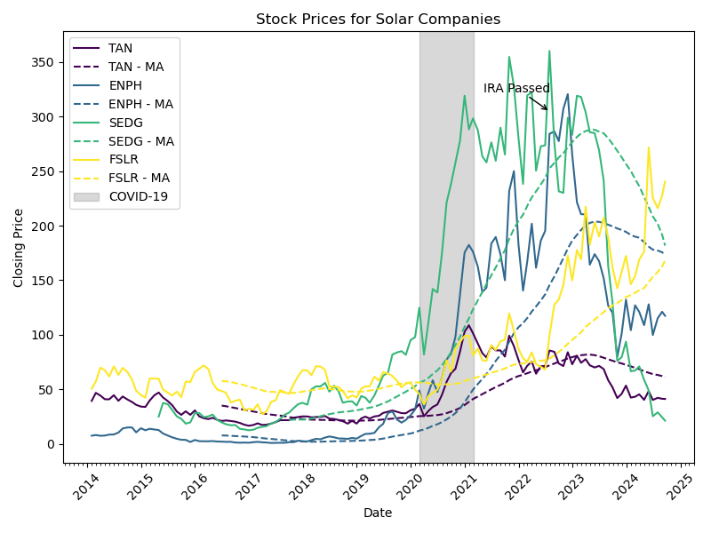
Discussion Point # 5 (Austin)
How have global renewable energy policies and incentives impacted the stock performance of companies in each sector?
Solar
IRA (Inflation Reduction Act) in 2022 had strong impact in growth
Investment Boost : IRA extended Investment Tax Credit through 2032
Domestic Manufacturing : Incentives for domestic production in USA
Deployment Acceleration: Solar capacity in US expected to double by 2027 due to IRA’s favorable policies

Slide 17
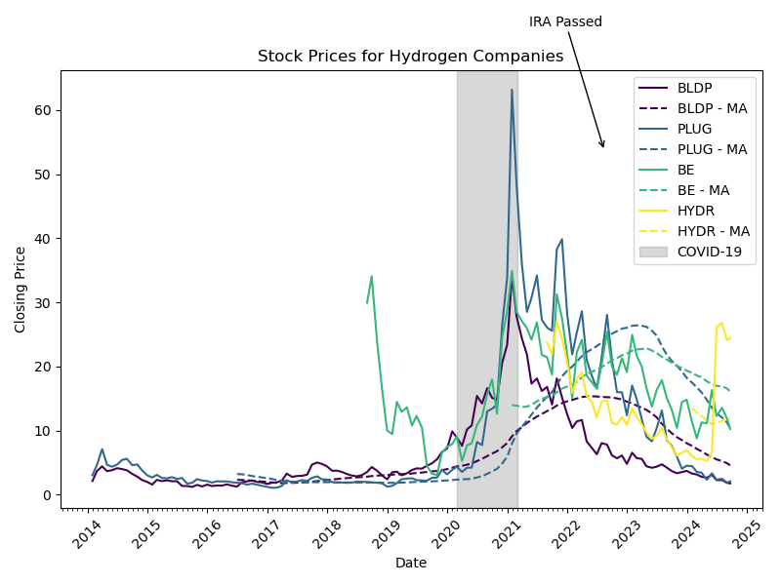
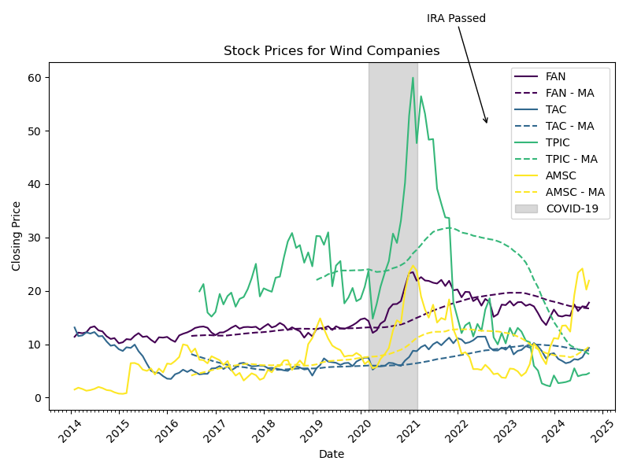
Discussion Point # 5 (Austin)
Hydrogen
Wind
IRA’s green hydrogen tax credits (up to $3 per kg) have attracted significant investment and led to stock growth for hydrogen companies by making hydrogen production more economically viable.
IRA extended tax credits for wind projects through 2032, providing financial certainty expected to double U.S. wind capacity by 2027, especially boosting offshore wind.

Slide 18
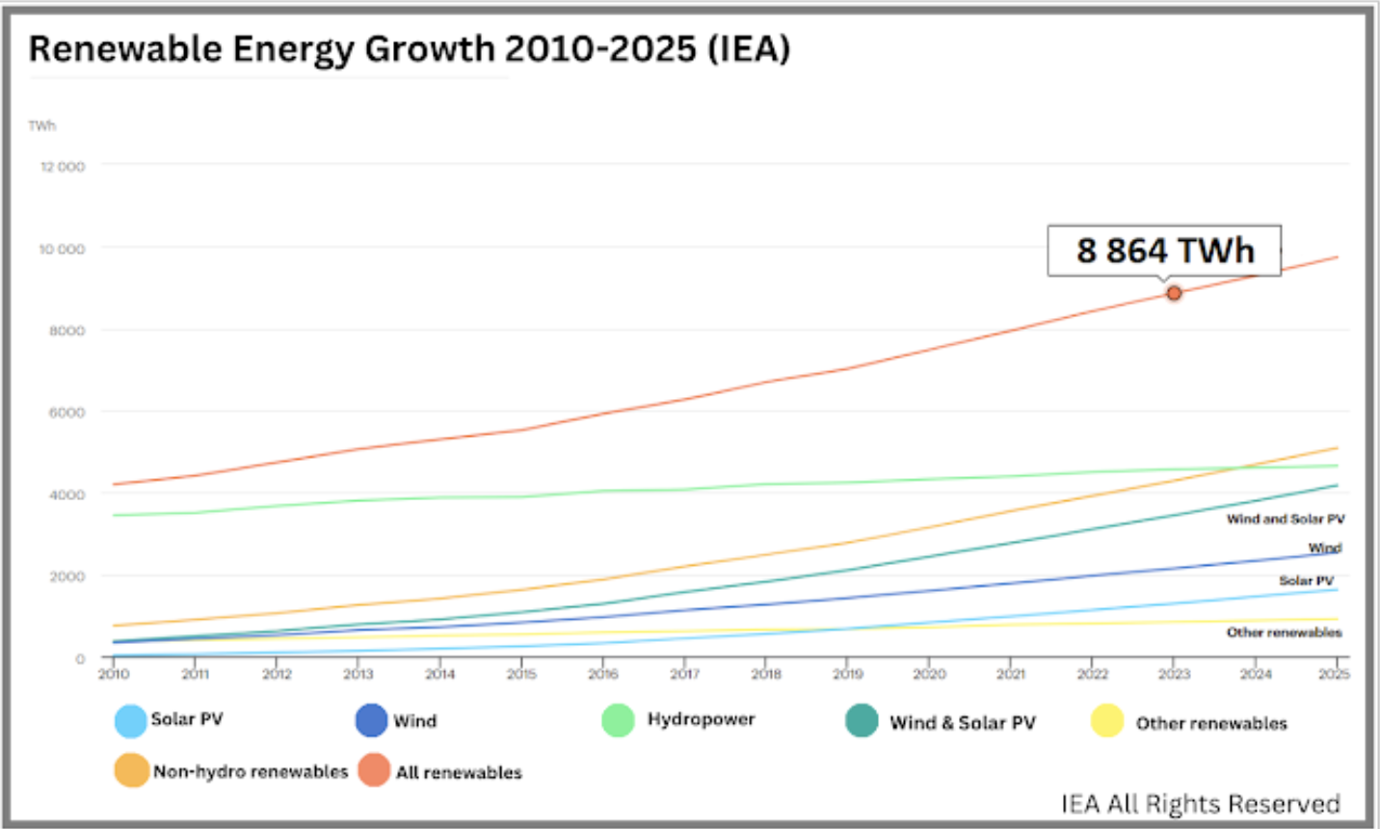
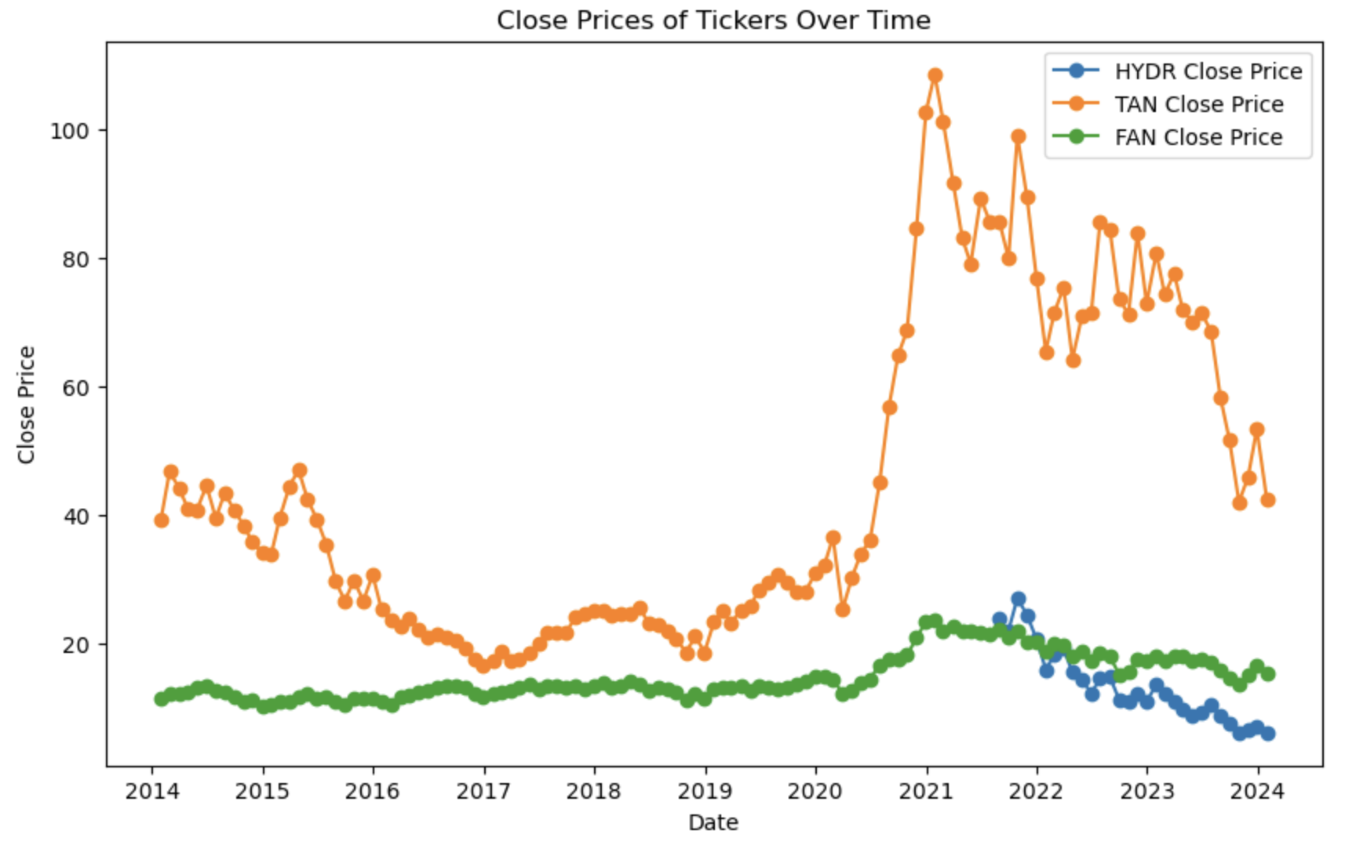
Is there a correlation between renewable energy growth and the stock performance of various renewable energy sectors?
Discussion Point # 6 (Phillip)
Global Renewable Energy Capacity
Generally steady growth - beginning to accelerate
ETF Close Prices 2014-2024
HYDR Close Price Range: 20.93
TAN Close Price Range: 92.12
FAN Close Price Range: 13.31

Slide 19

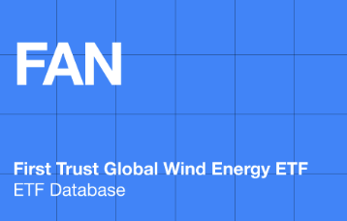

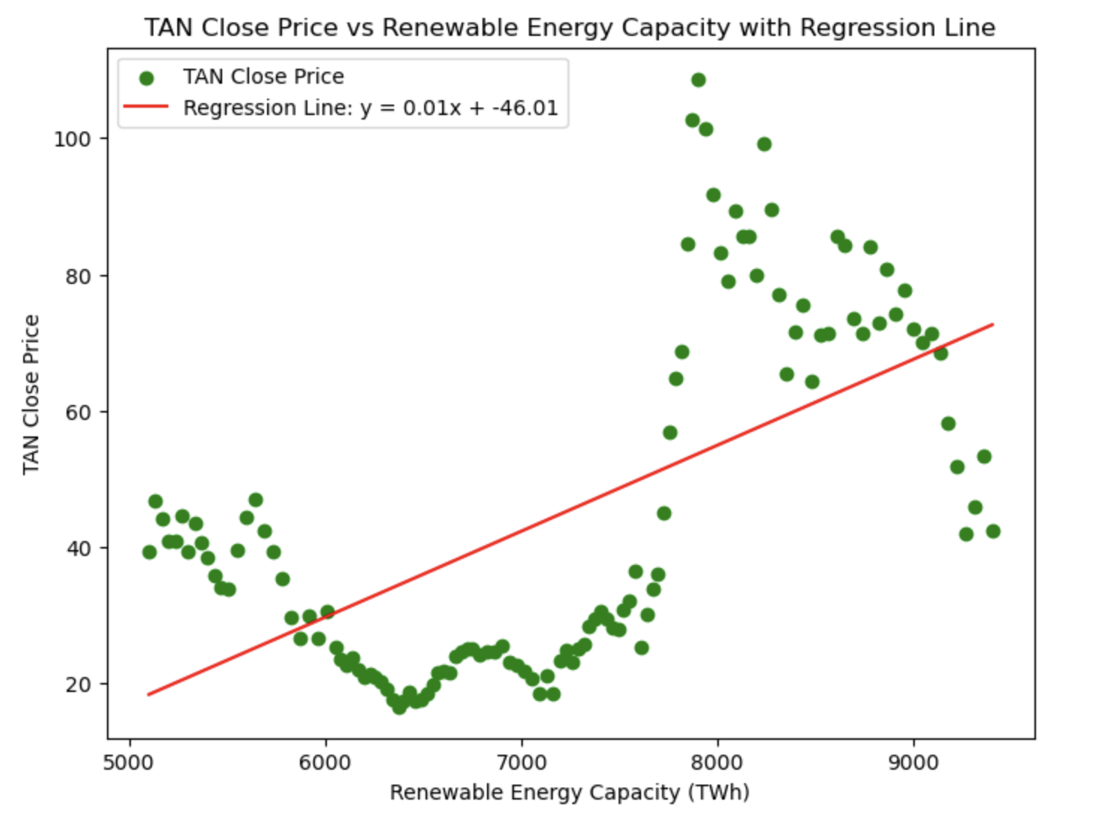
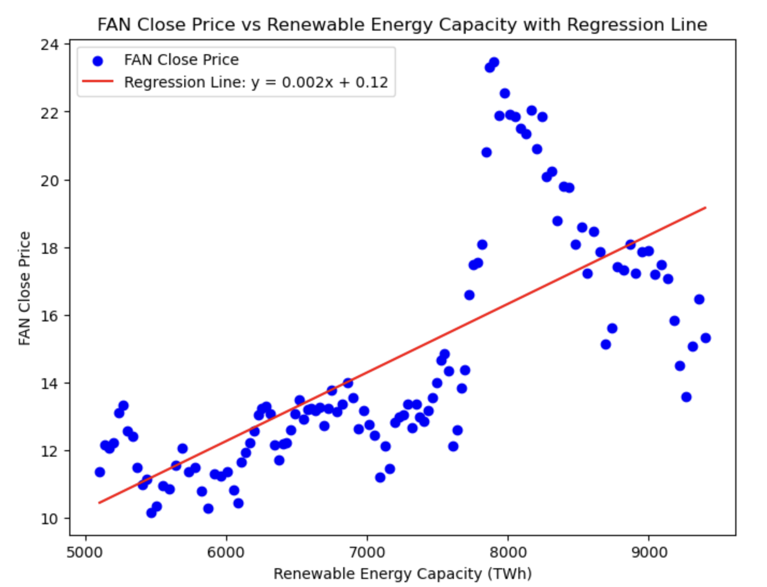
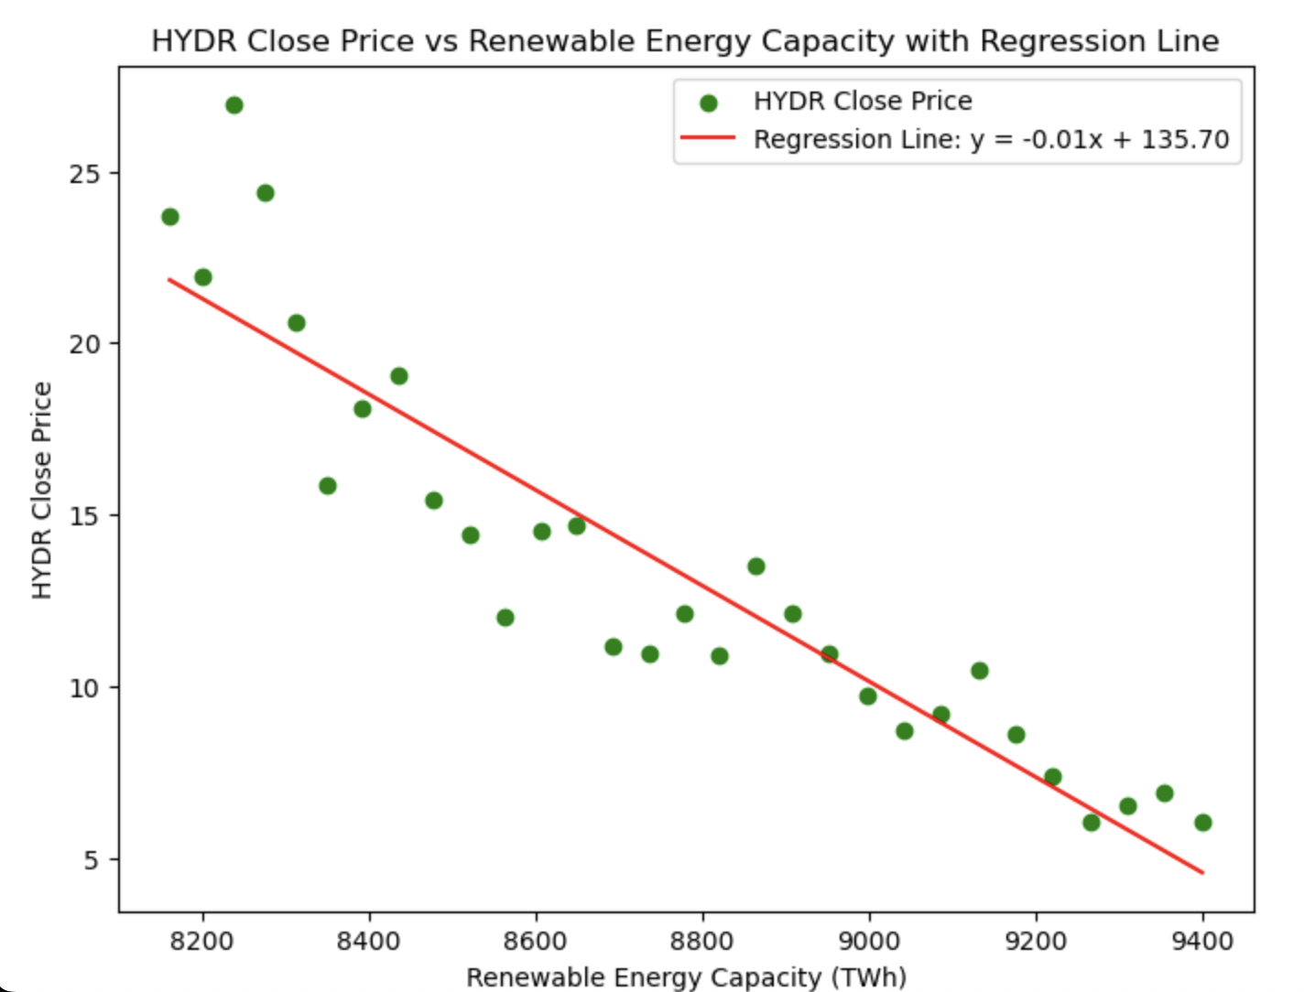
Solar ETF
Wind ETF
Hydrogen ETF
Pearson correlation coefficient = 0.608
Pearson correlation coefficient = 0.711
Pearson correlation coefficient = -0.924

Slide 20
Conclusion
Findings
Pandemic accelerated global shift to renewable energy by reducing fossil fuel demand, creating opportunities for green stimulus investments, and increasing public and political focus on sustainability.
Inflation Reduction Act (IRA) of 2022 further boosted the renewable energy transition post-pandemic by offering long-term tax incentives and policy certainty, significantly accelerating investments
Obstacles
API call limit made it challenging to retrieve the data we needed efficiently
Next steps
For further analysis, we could broaden the scope to include additional companies and ETFs to deepen the research of each sector
Securing more robust API services could enhance our data retrieval capabilities, allowing us to not only reflect on past trends but also to develop more precise forecasts for the future

